Slide 1
Multiplexing and Switching

Slide 2
Multiplexing - how links are shared between sessions
Switching - how traffic is switched from input to output ports at nodes.

Slide 3
Conceptually multiplexing is very similar to medium access control.
The main difference is with medium access control, users accessing the channel are geographically separate, so coordination and contention arise.
With multiplexing the channel sharing is done at one location, namely in a switch, so contention and coordination are not as difficult.
As with medium access control, multiplexing techniques can be divided into static and dynamic approaches (usually called statistical multiplexing).
With static approaches each user is allocated a sub-channel, i.e. a fixed portion of the channel, while with dynamic approaches the allocation varies according to demand.

Slide 4
MULTIPLEXING
Bandwidth utilization is the wise use of available bandwidth to achieve specific goals.
Efficiency can be achieved by multiplexing; i.e., sharing of the bandwidth between multiple users.
Whenever the bandwidth of a medium linking two devices is greater than the bandwidth needs of the devices, the link can be shared.
Multiplexing is the set of techniques that allows the (simultaneous) transmission of multiple signals across a single data link.

Slide 5
Types of Multiplexing
Frequency-Division Multiplexing
Wavelength-Division Multiplexing
Time-Division Multiplexing
Synchronous Time-Division Multiplexing
Statistical Time-Division Multiplexing

Slide 6
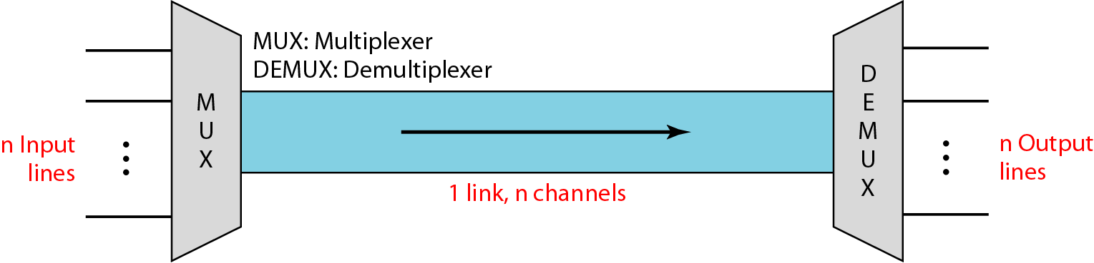
Dividing a link into channels

Slide 7
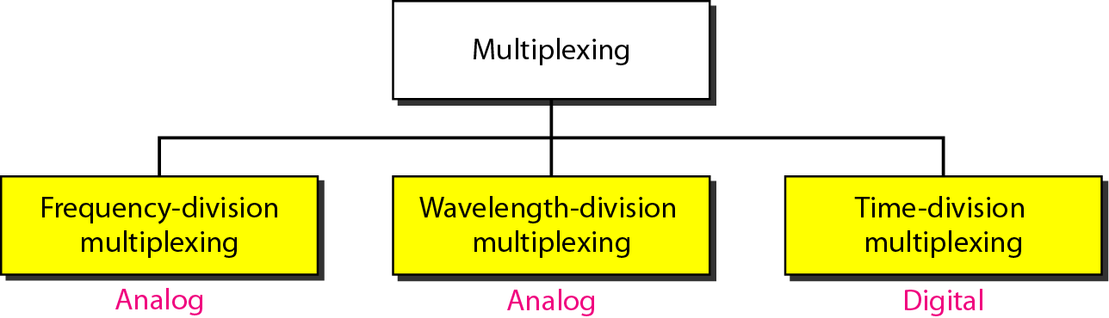
Categories of multiplexing

Slide 8
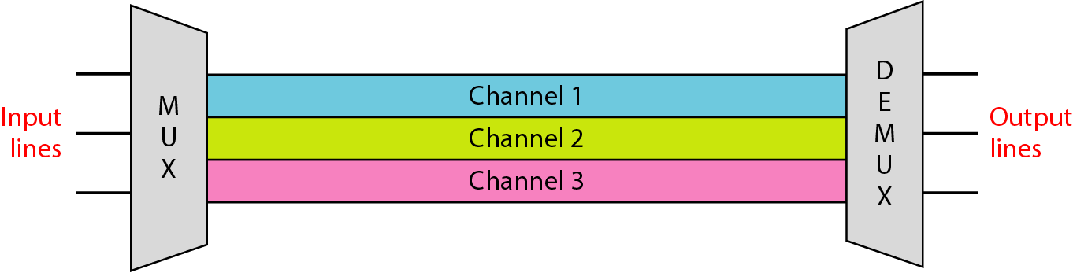
Frequency-division multiplexing (FDM)

Slide 9
The frequency spectrum of a link is divided up into disjoint bands and a separate band is assigned to each session.
Useful bandwidth of medium exceeds required bandwidth of channel
Each signal is modulated to a different carrier frequency
Carrier frequencies are separated so signals do not overlap (guard bands)
e.g. broadcast radio
Channel allocated even if no data

Slide 10
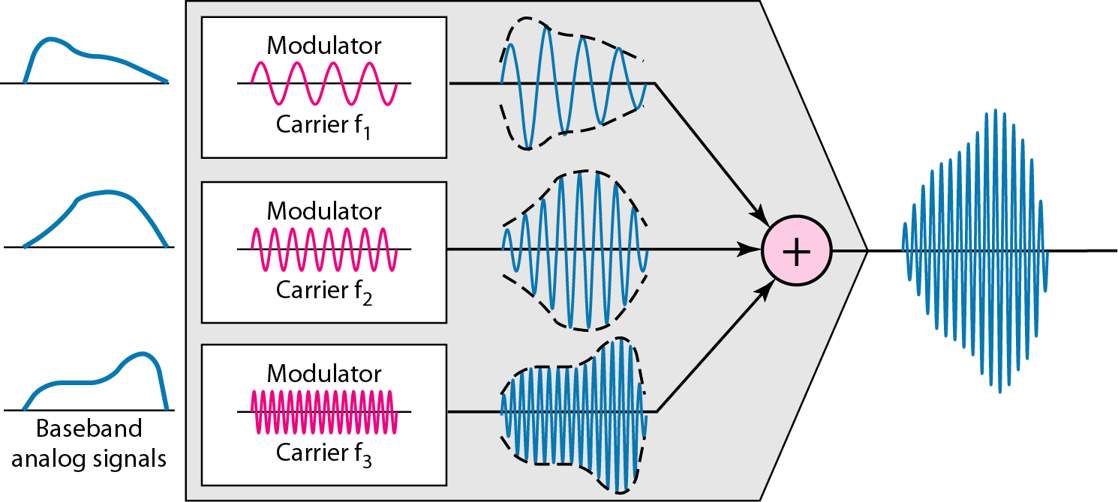
FDM process

Slide 11
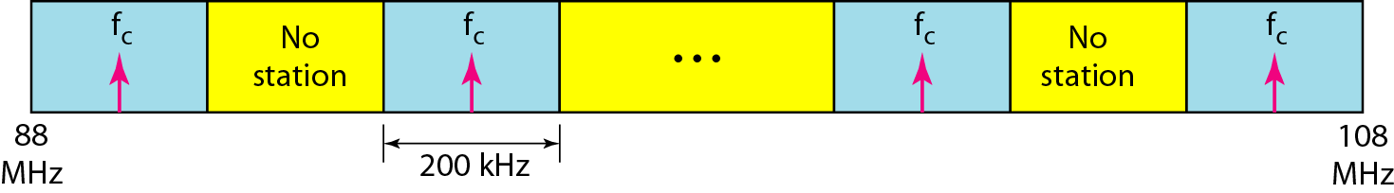
FM

Slide 12
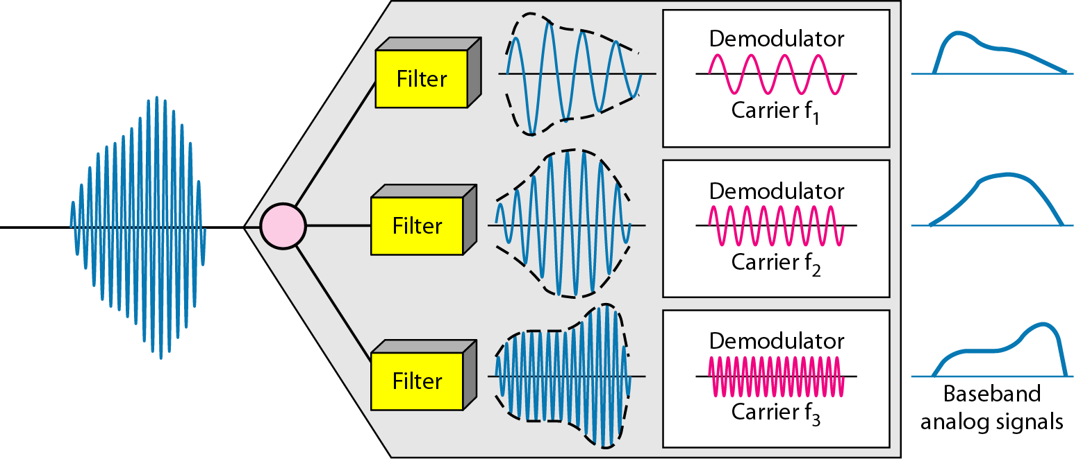
FDM demultiplexing example

Slide 13
Advantages of FDM:
1. The users can be added to the system by simply adding another pair of
transmitter modulator and receiver demodulators.
2. FDM system support full duplex information (Both side simultaneous
Communication) flow which is required by most of application.
Disadvantages of FDM:
1. In FDM system, the initial cost is high. This may include the cable between the
two ends and the associated connectors for the cable.
2. A problem with one user can sometimes affect the others.
3. Each user requires a precise carrier frequency for transmission of the signals.

Slide 14
Wavelength-division multiplexing (WDM)
WDM is an analog multiplexing technique to combine optical signals.
When FDM is used in optical communication systems it is called WDM.
In WDM systems, different sessions modulate light sources (LED's or lasers) at different wavelengths (frequencies) over the same fiber. These signals can then be separated using optical components such as diffraction gratings.
Using WDM current systems can multiplex 40-128 channels onto single optical fiber at rates of 2.5 - 10 Gbps each.
Low rate optical streams can be multiplexed together "all optically“ without any electrical conversion. This may also be done using passive optical components.
Each WDM wavelength can be treated independently and used for analog or digital data. In many cases, WDM is combined with TDM.

Slide 15
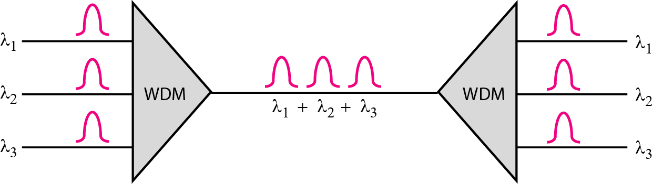
Wavelength-division multiplexing (WDM)

Slide 16
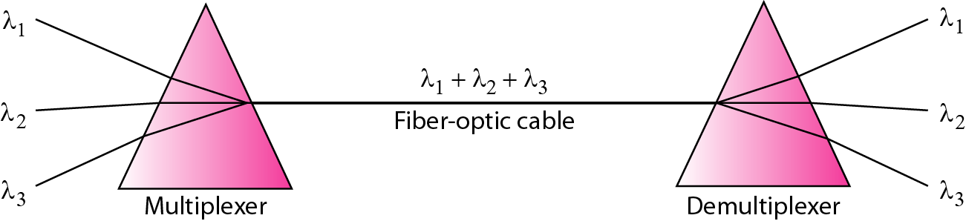
Prisms in wavelength-division multiplexing and demultiplexing

Slide 17
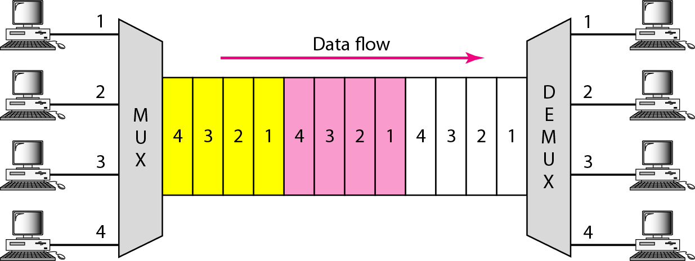
Time Division Multiplexing (TDM)

Slide 18
TDM is a digital multiplexing technique for combining several low-rate digital channels into one high-rate one.
Time is divided up into slots and each session is assigned a given set of slots in a cyclical order.
Each slot could correspond to the time to transmit either a single bit or byte from a user or a fixed size packet. The sequence of time-slots, 1 per user is called a frame.

Slide 19
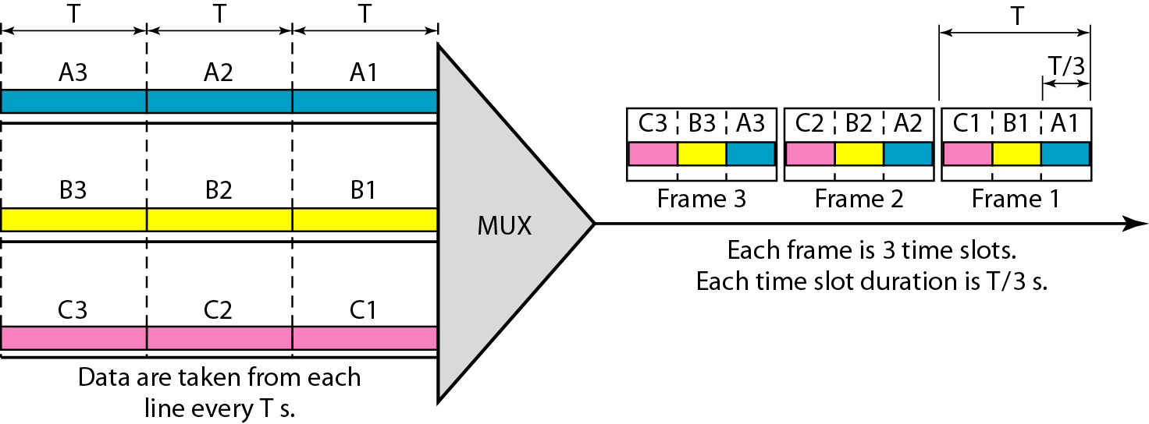
Synchronous time-division multiplexing

Slide 20
Synchronous Time Division Multiplexing
Data rate of medium exceeds data rate of digital signal to be transmitted
Multiple digital signals interleaved in time
May be at bit level of blocks
Time slots preassigned to sources and fixed
Time slots allocated even if no data
Time slots do not have to be evenly distributed amongst sources

Slide 21
In synchronous TDM, the data rate of the link is n times faster, and the unit duration is n times shorter.
Interleaving
The process of taking a group of bits from each input line for multiplexing is called interleaving.
We interleave bits (1 - n) from each input onto one output.

Slide 22
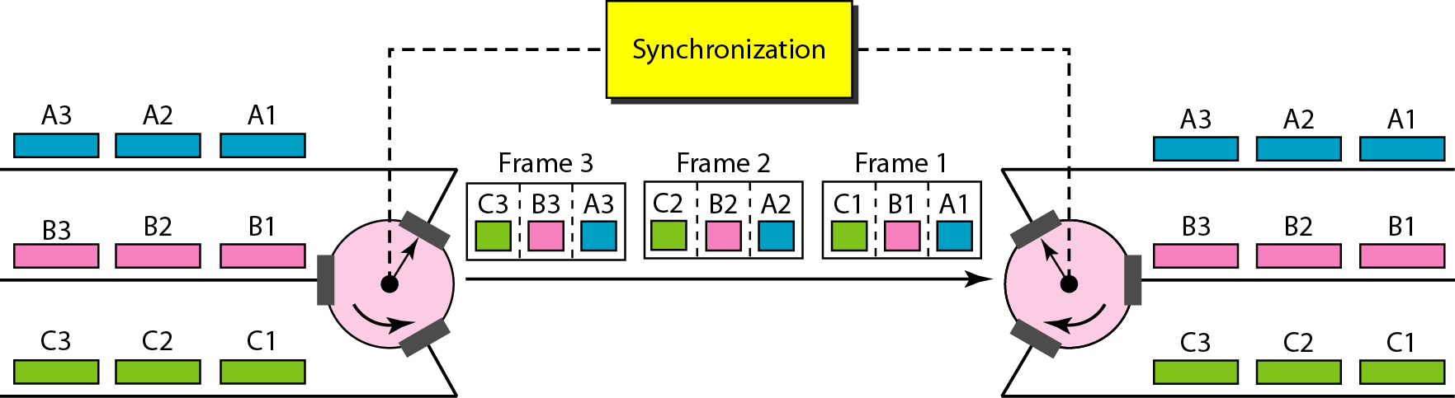

Slide 23
Statistical TDM
In Synchronous TDM many slots are wasted
Statistical TDM allocates time slots dynamically based on demand
Multiplexer scans input lines and collects data until frame full
Data rate on line lower than aggregate rates of input lines

Slide 24
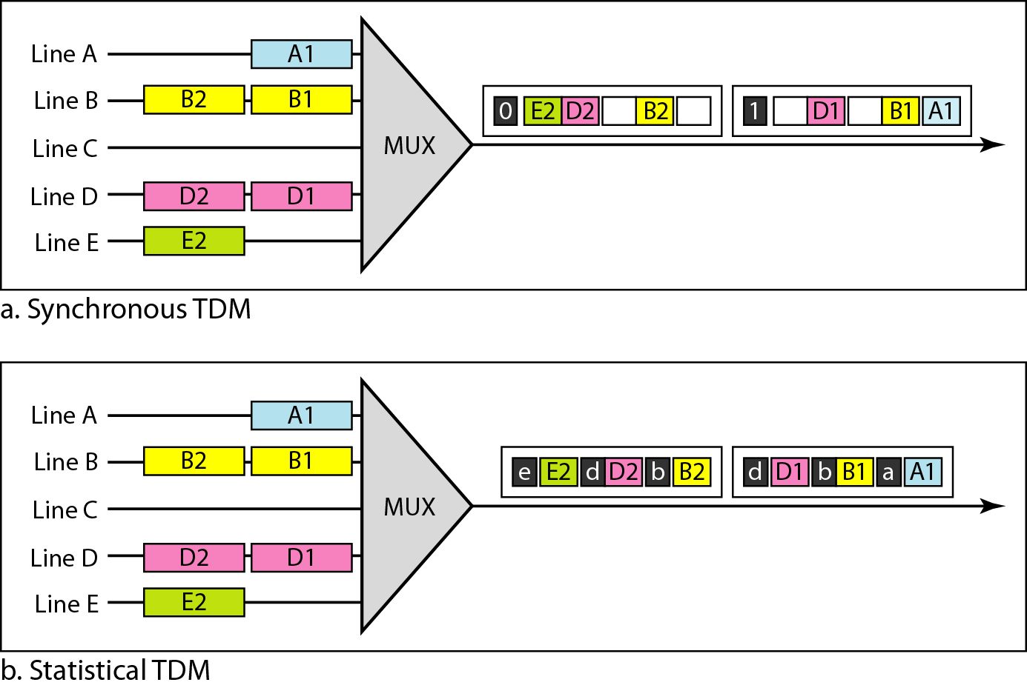

Slide 25
Advantages of TDM
1. It uses a single link
2. It does not require precise carrier matching at both end of the links.
3. Use of the channel capacity is high.
4. Each to expand the number of users on a system at a low cost.
5. There is no need to include identification of the traffic stream on each packet.
Disadvantages of TDM
1. The sensitivity to other user is very high and causes problems
2. Initial cost is high
3. Technical complexity is more

Slide 26
SWITCHING

Slide 27
Switching Networks
A collection of nodes and connections is a communications network
Long distance transmission is typically done over a network of switched nodes
Data routed by being switched from node to node
Nodes not concerned with content of data
End devices are stations
Computer, terminal, phone, etc.

Slide 28
Nodes
Nodes may connect to other nodes only, or to stations and other nodes
Node to node links usually multiplexed
Network is usually partially connected
Some redundant connections are desirable for reliability

Slide 29
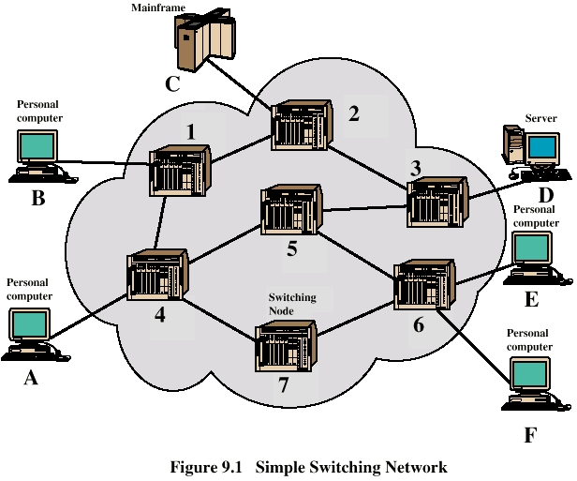
Simple Switched Network

Slide 30
SWITCHING
How traffic is switched from input to output ports at nodes.
The passage of a message from a source to a destination involves many decisions
When a message reaches a connecting device, a decision needs to be made to select one of the output ports through which the packet needs to be send out.
In other words, the connecting device acts as a switch that connects one port to another port.

Slide 31
Types of switching
Circuit switching and packet switching.
Circuit switching is used with static multiplexing techniques,
while packet switching is used primarily with statistical multiplexing.

Slide 32
Circuit Switching
In circuit switching, the whole message is sent from the source to the destination without being divided into packets.
Dedicated communication path between two stations
Three phases
Establish
Transfer
Disconnect
Must have switching capacity and channel capacity to establish connection
Must have intelligence to work out routing

Slide 33
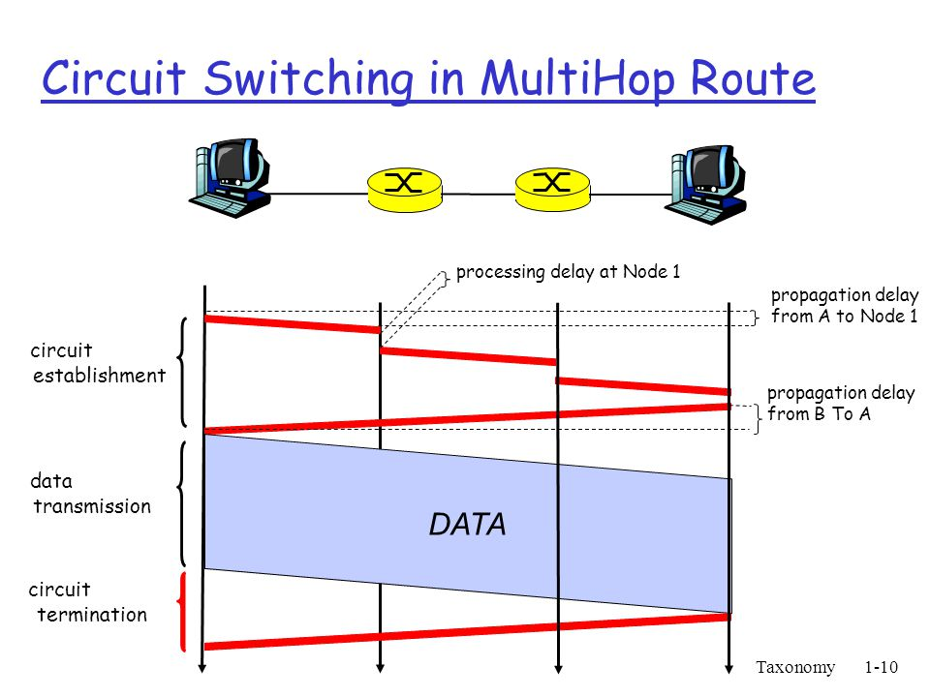

Slide 34
Circuit Switching - Issues
Circuit switching is inefficient (designed for voice)
Resources dedicated to a particular call
Much of the time a data connection is idle
Data rate is fixed
Both ends must operate at the same rate
Set up (connection) takes time
Once connected, transfer is transparent

Slide 35
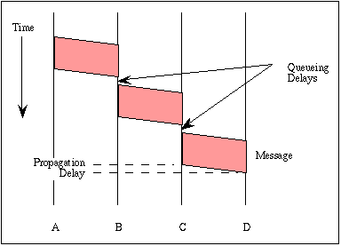
Message Switching

Slide 36
Packet Switching
To improve the efficiency of transferring information over a shared communication line, messages are divided into fixed-sized, numbered packets
Network devices called routers are used to direct packets between networks.
Basic Operation
Data transmitted in small packets
Typically 1000 octets
Longer messages split into series of packets
Each packet contains a portion of user data plus some control info
Control info
Routing (addressing) info
Packets are received, stored briefly (buffered) and passed on to the next node
Store and forward

Slide 37
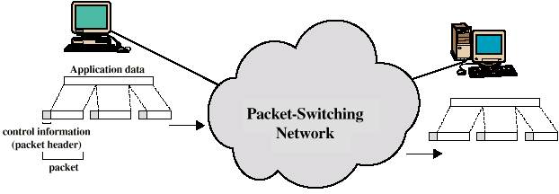
Use of Packets

Slide 38
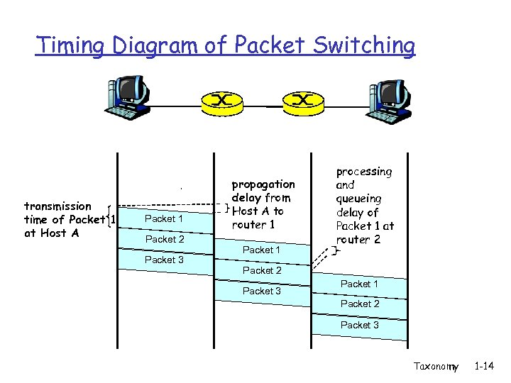

Slide 39
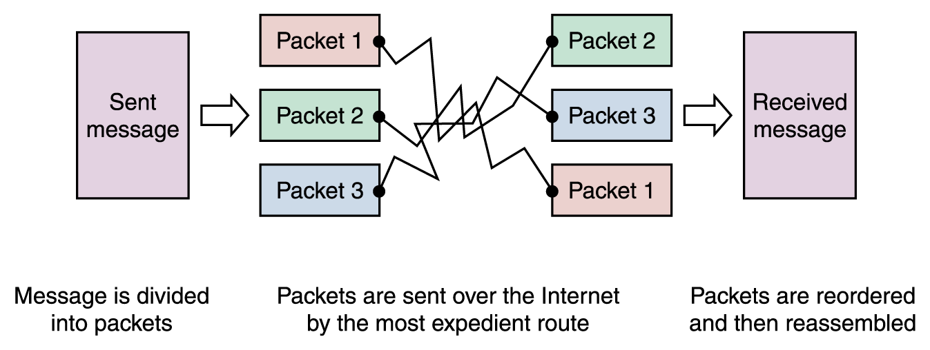
Packet Switching
Messages sent by packet switching

